Slide 1


FLORIDA HOUSING PROJECT
Kyle Morris
DSC 630
May
2020
Notes:
Good afternoon. My name is Kyle Morris, and I’m here to tell you about the Florida Housing Project. This project sought to analyze the housing market in the state of Florida, in order to gauge whether the selling price of a home matched its value.
As I currently live in the state of Florida and am looking to buy a house there in the near future, this topic spoke to me on a personal level and influenced some of the decisions made throughout the process.

Slide 2

INTRODUCTION
On Analysis of the Housing Market in Florida
Where our Data came from
How we validated and cleaned our Data.
How the most important features were selected.
How the model was created.
How the parameters of our model looked.
What challenges arose?
What did our final model look like?
How did the model compare to the actual data?
What can we conclude?
Notes:
These are the topics that we are going to cover today. In this presentation, we’re going to talk about where our data came from. We’ll then cover how our data was both validated, and cleaned. We’ll cover the process of how the most important features to the final price was selected. All of this ties in to how our model was created, and how the different parameters of the model began to take shape.
We’ll cover the challenges that came up in the process, and we’ll take a look at what the final model looked like.
We will of course show how the model outputs compared to the expected real world data and finally discuss some of the conclusions that we were able to come up with.

Slide 3

PROBLEM
Given the attributes of a home, can we predict the fair market value of the residence?
The information came from the Census bureau directly.
While data is available for all 50 states, the District of Columbia, and Puerto Rico, this model is focused on the Florida portion.
The 2018 data is utilized. While we can adjust for inflation and incorporate multiple year’s worth of data in the analysis, only the most recent data will be used.
Notes:
The basic premise of the Florida Housing Project was as such: given the attributes of a home, can we predict the fair market value of said residence and, by comparing that to the current offering or sale price of a home, was said residence a good deal?
Our data comes directly from the US Census Bureau. While this data is available for all 50 US States, District of Colombia, and Puerto Rico, the decision was made to restrict the data to Florida only. Each state is unique, and a model designed for and trained using Florida data does not necessarily transfer well to other states, due to each housing market being so very different.
2018 was the most recent year that data was available, and so it was used for this analysis. While there are multiple year’s worth of data available, we would have had to compensate for inflation. While the data provides this information, we were hesitant to make predictions based on the behavior of a real estate market that changes so rapidly. Thus, 2018 data was selected.

Slide 4

DATA SOURCE
2018 American Community Survey by the US Census Bureau
Notes:
Our data comes directly from the US Census Bureau, provided in a comma-separated values file or CSV.
The American Community Survey is an ongoing survey that provides vital information about our nation and its people, and is used to allocate more than $675 billion worth of federal and state dollars each year.
It is separate from the ten year Census, although it is run by the same government department. Data is provided for each of the 50 US States, District of Colombia, and Puerto Rico. Data is collected from January to December each year – currently, 2018 is the most up to date data available.

Slide 5
DATA CLEANING
3 categories of variables were identified for the purposes of missing numbers:
0 As Valid Value
Mean Appropriate
['BDSP', 'HUGCL', 'NPP', 'NR', 'NRC', 'PARTNER', 'PSF', 'R18', 'R60', 'R65', 'SRNT', 'SSMC', 'SVAL’]
-1 was used for missing values since 0 was a valid response.
These columns were categorical variables coded as numbers and so the mean would not make sense.
'FINCP', 'OCPIP', 'SMOCP’]
Since these were actual values (such as monthly rent, average electricity, etc.) and 0 would not be appropriate, the mean was used for these.
By using the mean, we would avoid creating outliers that would impact the analysis.
All Others
0 was an appropriate value for missing values and so it was used.
Notes:
The data from the ACS is collected via survey response. As such, there is no guarantee that respondents will answer every question completely. We did have some missing values to take care of. There were 3 categories of values identified: the 0 group, the -1 group, and the mean appropriate group.
The -1 group was made up of values for which 0 was a valid response, and the mean would not have been appropriate. These columns are:
[BDSP] # of bedrooms, [HUGCL} household with grandparent living with grandchildren, [NPP] grandparent headed household with no parent present, [NR] presence of nonrelative in household, [NRC] number of related children in household, [PARTNER] unmarried partner household, [PSF] presence of subfamilies in household, [R18] presence of persons under 18 years in household, [R60] and [R65] presence of persons 60 and 65 years, respectively, and over in household, [SRNT] specified rental unit (a single-family home on 10 or more acres, less than 10 acres, or otherwise), [SSMC] same-sex married couple households, and [SVAL], specified owner unit. These groups had missing values filled in with -1, in order to avoid assigning more weight to the 0 case.
The next group were columns where it made more sense to use the average as a missing value. These columns were [FINCP] , family income, past 12 months, [OCPIP], monthly owner costs as a percentage of household income, past 12 months, and [SMOCP], selected monthly owner costs.
The remaining values did not use 0 as a valid value, and so 0 was used to fill in missing numbers.

Slide 6
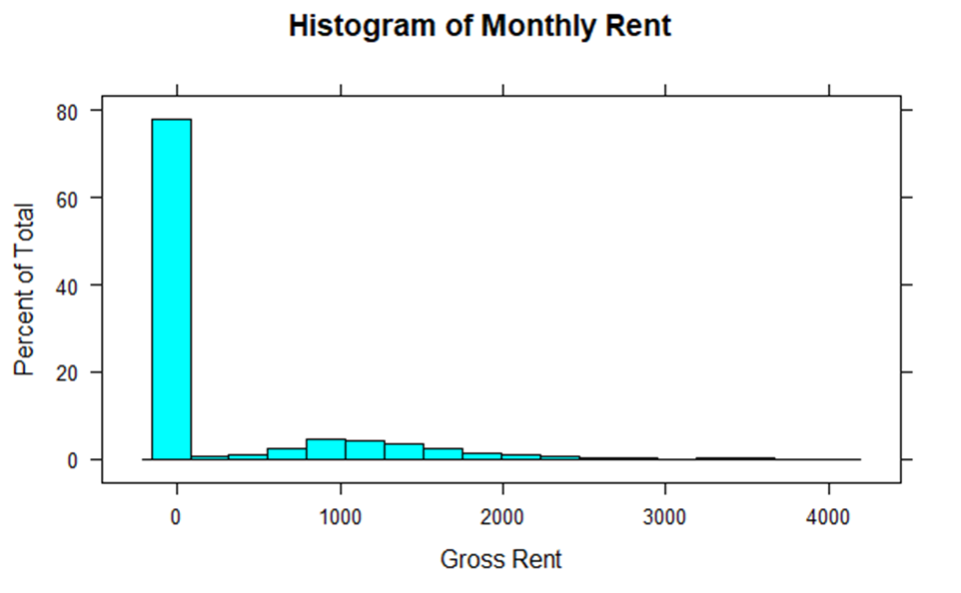
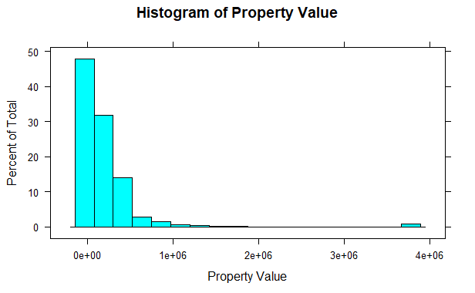
INITIAL GRAPHS
Gross Rent had a large spike at 0, while Property Value was positively skewed.
Notes:
Once cleaned and imported, we wanted to look at our data to see how our values were distributed. Many models have specific requirements and without taking care to address our data, model assumptions may be broken which results in a false model.
In this case, we’re interested in two specific variables, which our models will attempt to predict. The first, [RNTP], is the gross rent per month. If a home was owned instead of rented, then it would have a mortgage instead. Thus, as you can see we have a large amount of values that are $0 in the rent field.
The second variable, [VALP], is the Property Value. A home will have a value whether it is rented or owned. In this case, we have a lot of values closer to 0 but some quite expensive homes as well.
The decision was made to omit the $0 [RNTP] homes from the rent analysis, and to apply a log transformation to the [VALP] columns.

Slide 7
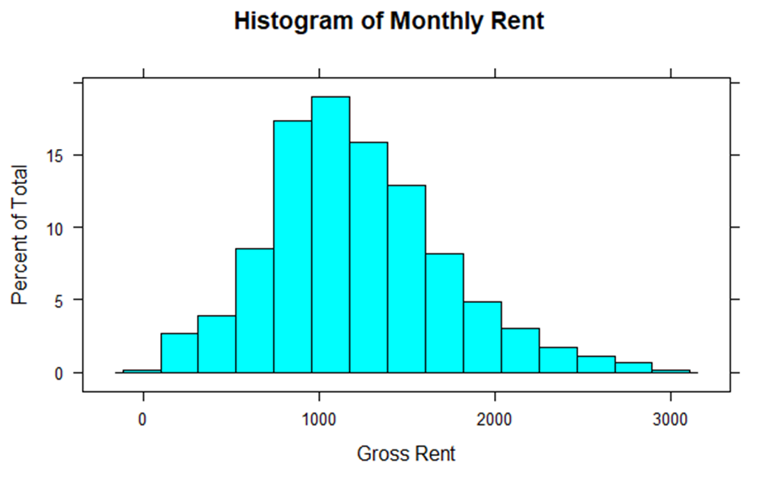
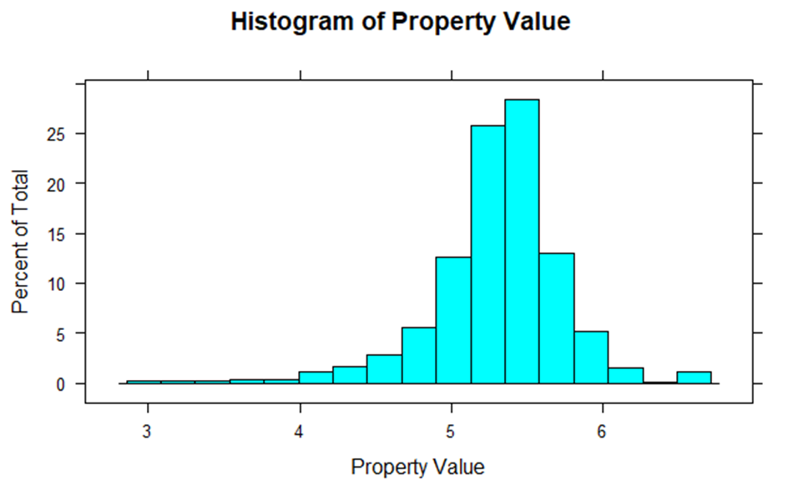
POST CLEANUP
After the changes, the data was much more normally distributed.
Notes:
This is how the previous two graphs appear after the transformations have been applied. As you can see, they much more resemble the symmetric Normal distributions than they did previously. We have a little bit of a longer tail than we would like on the Property Value chart, but overall the transformation was a net win for data wrangling.

Slide 8
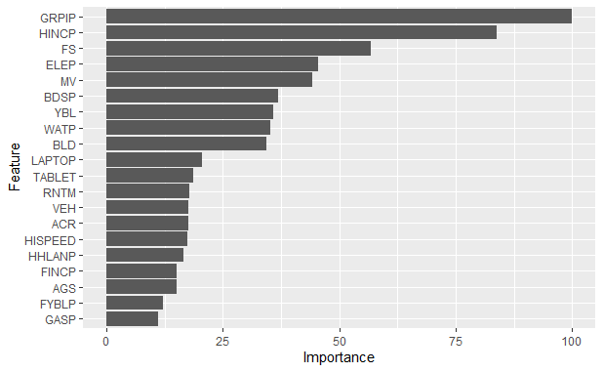
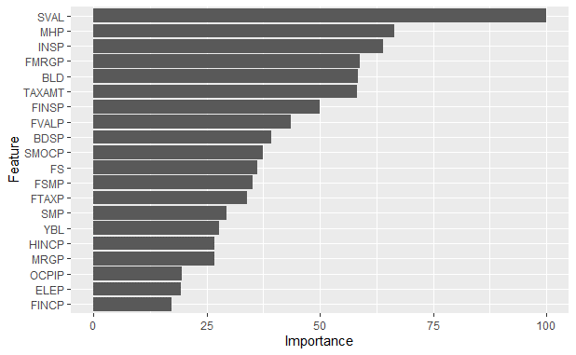
FEATURE SELECTION
Monthly Rent
Varimp was used to classify the important features.
Only the ones most important to determining the value will be used in the model.
Property Value
Notes:
There were 231 variables in our original dataset, but not all variables are as important to the final model as others. We want to pare this down to the variables that are more important indicators as this speeds up the model while vary rarely sacrificing accuracy. We used a function called Varimp to assist us in selecting the features that are important to our model. Essentially, it ranks each feature by importance to the variable we’re trying to predict, either monthly rent or property value.
These charts were created before trimming down the model. We threw every feature in in order to pick out the most important ones. Originally, we had one feature in each that was identical to the predicted value, which obviously made the model a trivial exercise. It has since been removed.
The top 7 features were the ones that passed the 50 threshold. The model was then adjusted to incorporate only these features.

Slide 9
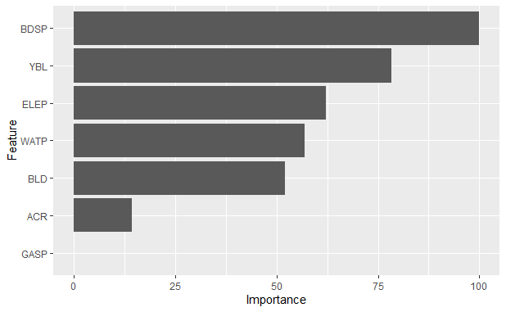
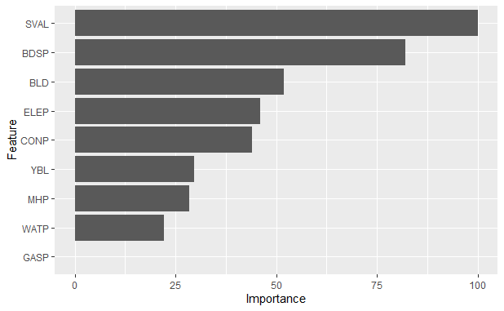
FEATURE SELECTION FIXED
Monthly Rent
Some variables had no effect or were the dependent variable under a different format.
These are the previous charts, but only showing the columns deemed most important.
Property Value
Notes:
The important factors for Monthly Rent: [BDSP], [YBL], [ELEP], [WATP],[BLD], [ACR], and [GASP]. For Property Value, it’s [SVAL], [BDSP], [BLD], [ELEP], [CONP], [YBL], [MHP], [WATP], and [GASP].
These short names are hard to understand. Luckily, the Census Bureau provides a dictionary. For Monthly Rent, we ‘ve got Number of Bedrooms, Year Structure Built , Electricity Monthly Cost, Water Monthly Cost, Units in Structure, Lot Size, and Gas Monthly Cost. For Property Value, it’s Specified Owner Unit, Number of Bedrooms, Electricity Cost, Condo Fee, Year Structure Built, Mobile Home Costs, Water Monthly Cost, and Gas Monthly Cost.
These features were the final ones used in the model.

Slide 10
MODEL CREATION
Two models were created, one for predicting Monthly Rent, the other for predicting Property Value.
Linear Regression was used for both models.
Linear Regression is useful due to its linearity and the results are easy to interpret – each coefficient represents the weight that that column has on the final results.
Notes:
Model creation is where the magic actually happens! The previously selected features were loaded into the model. We chose Linear Regression as the basis for the model. Linear Regression works well when the relationship between columns and the final result. Housing prices seem to meet this criteria – generally, the more features a home has, the more expensive it is.
Linear Regression is also easy to interpret. Each column is assigned a coefficient, which changes the weight it has on the final result.
We’ll see those coefficients on the next slide, which will help explain how changes in one column affect the overall predicted price.

Slide 11
MODEL COEFFICIENTS
Final coefficient outputs from the model. Each coefficient shows the weight of that column in the final value.
Property Value Model
Intercept | SVAL | BLD | MHP | BDSP | YBL | CONP | ELEP | WATP | GASP
5.30326487 | 0.149084 | 0.102204 | -0.04792 | 0.10835 | 0.042578 | 0.080054 | 0.063853 | 0.036906 | 0.015506
Rent Model
Intercept | BDSP | ELEP | YBL | WATP | BLD | ACR | GASP
1216.251757 | 150.4366 | 92.09602 | 98.6556 | 77.07377 | 125.7296 | 45.76685 | 9.230444
Notes:
Here are the results for our model. Keep in mind the Property Value is on a log scale, which explains the much smaller coefficients compared to Rent Model.
For the most part, there are no surprises here. We selected features based on how much they affected the final result – thus, the more important features should have more of an effect on the price.

Slide 12
CHALLENGES
What was done to optimize the model?
Missing data and how to handle it was a huge factor, given that the data came from self-submitted surveys.
Some of the data wasn’t normalized, which was a requirement for analysis and so transformation techniques were applied.
Data came in one set, and in order to assess the power of a model we need to be able to compare the predicted output to the actual values, so some records were withheld as a testing set.
Notes:
That’s not to say our model was smooth sailing from start to finish. One of the biggest decisions we had to make, and one that we covered earlier in the presentation, was what to do about missing data. This isn’t a problem that has a single solution – there are many different ways of handling missing data, and the same technique wasn’t used for every bit of missing data. Removing the offending rows is an option, but that would have drastically reduced our training set.
In addition, some of the data sets did not follow a normal distribution. Many of the techniques used in predictive analytics rely on data following a specific distribution, so we had to apply transformation techniques to our data.
We wanted to be able to evaluate our model, so we couldn’t use our entire data set. We couldn’t evaluate a model’s ability to predict values that it already knew, of course! In order to test, we used a portion of the data – 75% - as our training set, and 25% as our testing set. This allowed us to use a significant portion of data for training, while still allowing us to test meaningfully on data not part of the original training set.

Slide 13
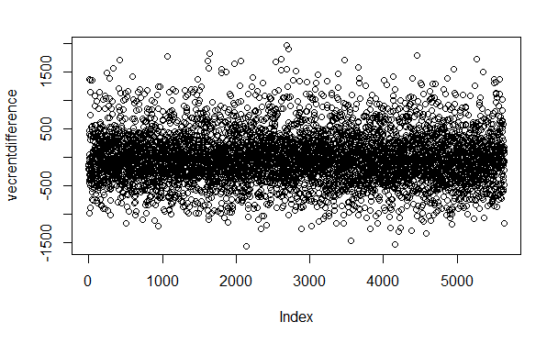
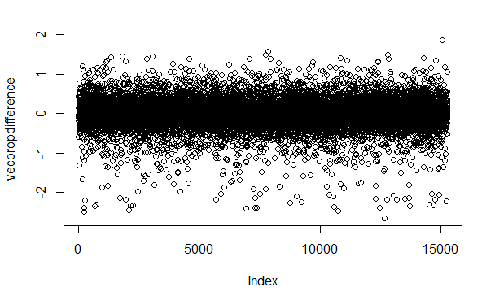
RESULTS
Monthly Rent
These graphs show the spread of the actual costs versus the predicted cost.
The majority of predictions are within ±500 or ±1.
Property Value
Notes:
How did we evaluate our model? In this case, we wanted to see how far off the predicted values (supplied by our model) compared to the actual values (supplied by our data). We then graphed the difference between the actual cost and predicted cost.
By plotting all roughly 5500 values in Rent, and 15000 values in Property Value, this allows us to see how our model compared to the actual values.
For Rent, you can see the very thick layer between positive and negative $500. This shows that the vast majority of predicted values fell within $500 of the actual value. If anything, the model somewhat underpredicted values, as the range of positive values shows more variety on the positive side.
For Property Values, keep in mind this is a log scale. Even so, we see most of our values fall between plus/minus 1. You can see this version is the opposite though – most property values were predicted to be higher than they actually were.

Slide 14
CONCLUSIONS
Useful tool to classify a property as overvalued, undervalued, or just right.
The vast majority of predictions fell in line with what we expected.
Data can easily be adapted for other states.
Model can be refined over time – when 2019 data comes out, can easily be run again to adapt to changes in the housing market over time.
Care must be taken not to use the model as gospel.
Notes:
Overall, we found our resultant models to be a useful stepping off point. The vast majority of our predictions fell in line with the values expected. There was, however, some variance – which is great, because it means there might be an opportunity where our model can identify undervalued properties in the market which can be capitalized upon.
While our data was specifically tailored towards the Florida market, we can easily adapt to other state markets. I would suggest starting from the feature selection stage. A basement in tornado alley is worth a lot more than in California, for instance!
The data can updated with each new yearly update. Since the ACS has been ongoing for multiple years, they do not often change the structure of the data. This would allow it to be updated quite nicely.
Care must be taken, however, to avoid treating the model as gospel. Predictive analytics simply looks to make sense of the chaotic world we find ourselves a part of – we aren’t mediums. Ultimately, the value of property and homes does have a human factor, and just because the model says something doesn’t mean it’s the only voice.
As a wise manager once said to an intern commenting on the weather forecast calling for blue skies, “Yes, but have you stuck your hand outside yet?”. Trust, but verify.

Slide 15

THANK YOU
Kyle
Morris
Email
kymorris@my365.Bellevue.edu
Notes:
Thank you so much for taking the time to learn a little bit about the Florida Housing Project. If you have any questions, I’ve provided my email and I’m happy to answer anything that you can throw at me.
I often choose my projects based on what’s going on and I’m currently in the market for my first home. Hopefully, what I’ve learned will pay off! Thank you for coming along on this Predictive Analytics journey with me!

